Slide 1
Vali IT
Testing

Slide 2
Unit Test
Unit Testing is a level of software testing where individual units/ components of a software are tested
A unit is the smallest testable part of any software
It usually has one or a few inputs and usually a single output.

Slide 3
Add Spring Validation dependency
<dependency>
<groupId>org.junit.jupiter</groupId>
<artifactId>junit-jupiter</artifactId>
<version>5.7.0</version>
<scope>test</scope>
</dependency>

Slide 4
Testing
All tests must be in test folder
When writing tests you can use all classes from main folder
By default configuration files from main folder will be used
You can add configuration files with same name to overwrite them for test profile

Slide 5
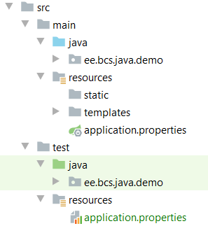
Testing
Tests have their own file structure

Slide 6
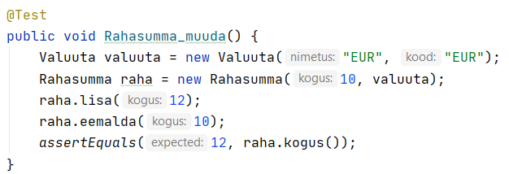
Testi kirjutamine

Slide 7
Integration testing
Tests that cover multiple units
Tests that cover multiple layers
Test that covers the whoule path through application

Slide 8
Embedded database for testing
If we try to test methods that connect to databse then we will use our default database
We can create embedded database for testing

Slide 9
Add H2 database dependency
<dependency> <groupId>com.h2database</groupId> <artifactId>h2</artifactId> <scope>test</scope> </dependency>
This dependency will be used only in testing

Slide 10
Add application.properties for test profile
spring.datasource.url=jdbc:h2:mem:testdb ;MODE=PostgreSQL
spring.datasource.driverClassName=org.h2.Driver
spring.datasource.username=sa
spring.datasource.password=password

Slide 11
Add new db.changelog-master.xml to test
databaseChangeLog: - include: file: db/changelog/db.changelog-1.0.yaml
- include: file: db/changelog/test-data.yaml
Add test-data.xml file to insert test data

Slide 12
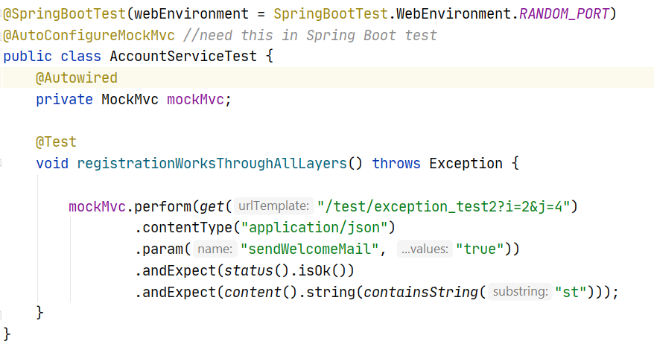
Sample Test

Slide 13
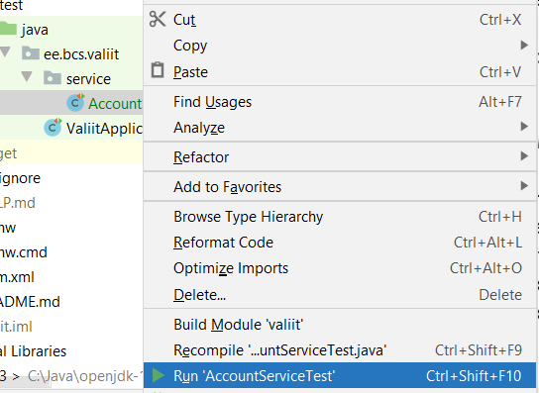
Running Tests

